Slide 1
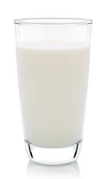
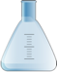
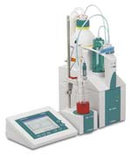
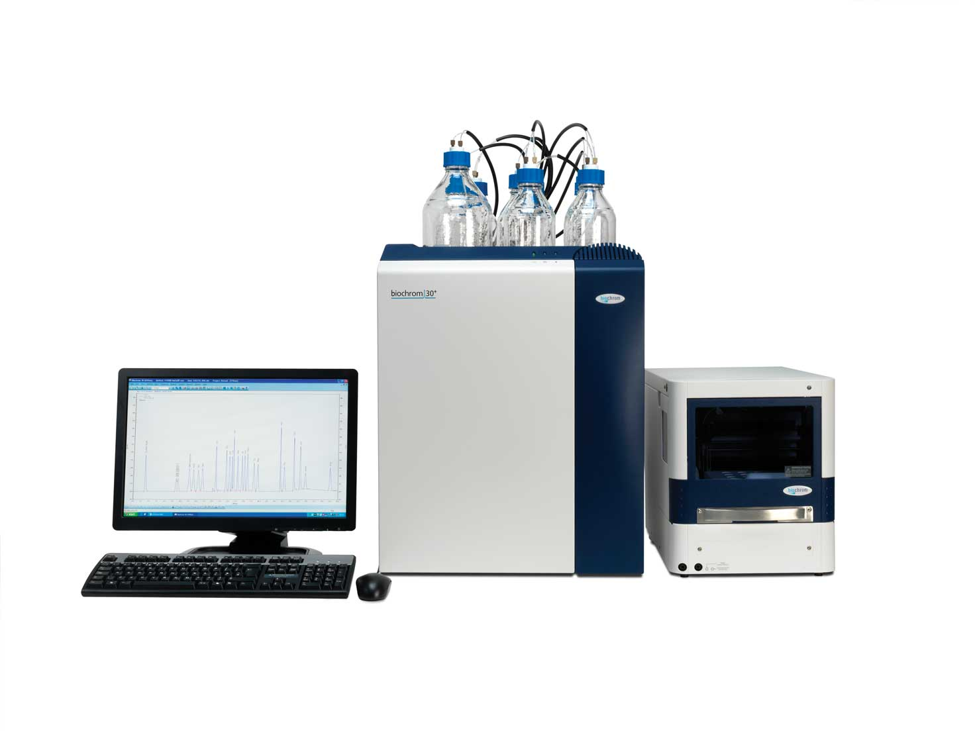
Lipid
Mixed
micelle
Digestion Model
Centrifuge
Sediment
Bioactive gastrointestinal bioavailability
pH 7
pH 3
pH 7
Mouth
Stomach
Small intestine
pH-Stat monitoring
Lipid digestions
Nutrient profiling

Slide 2
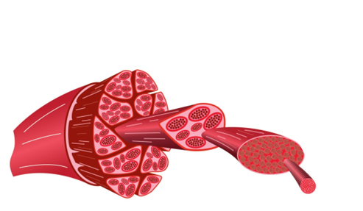
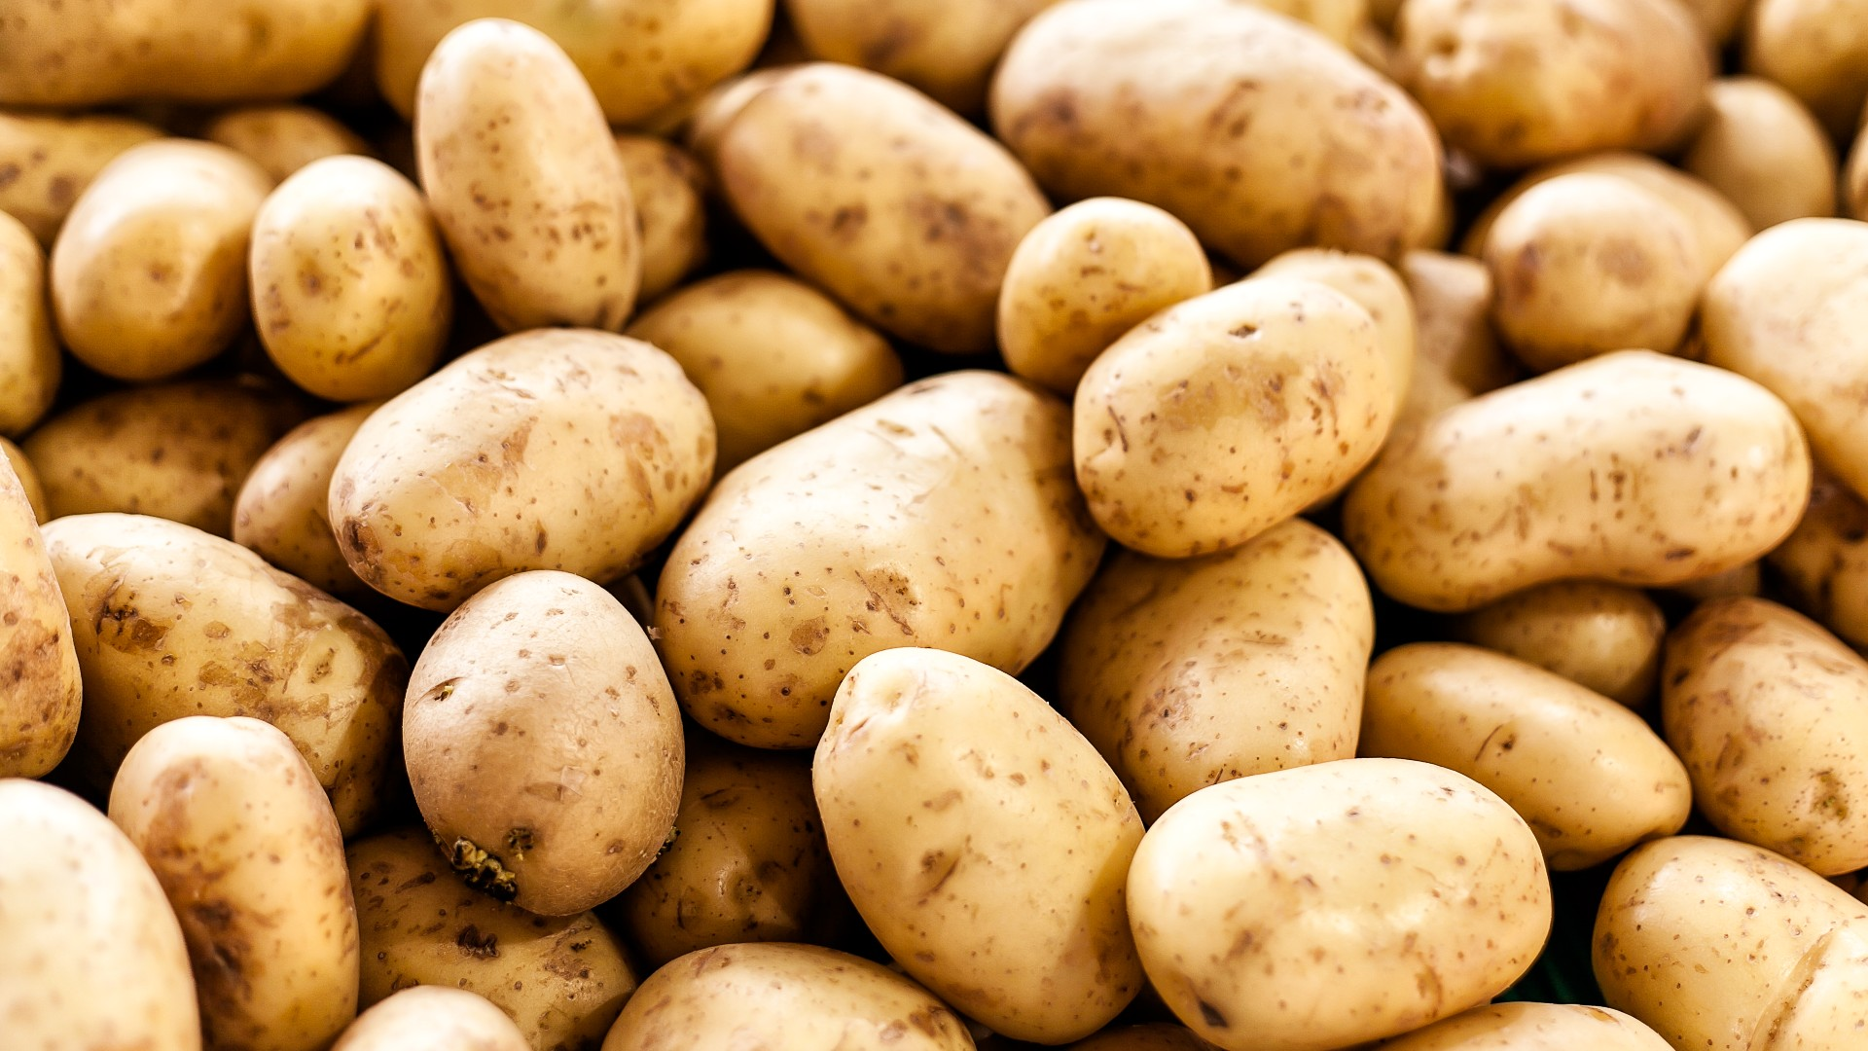
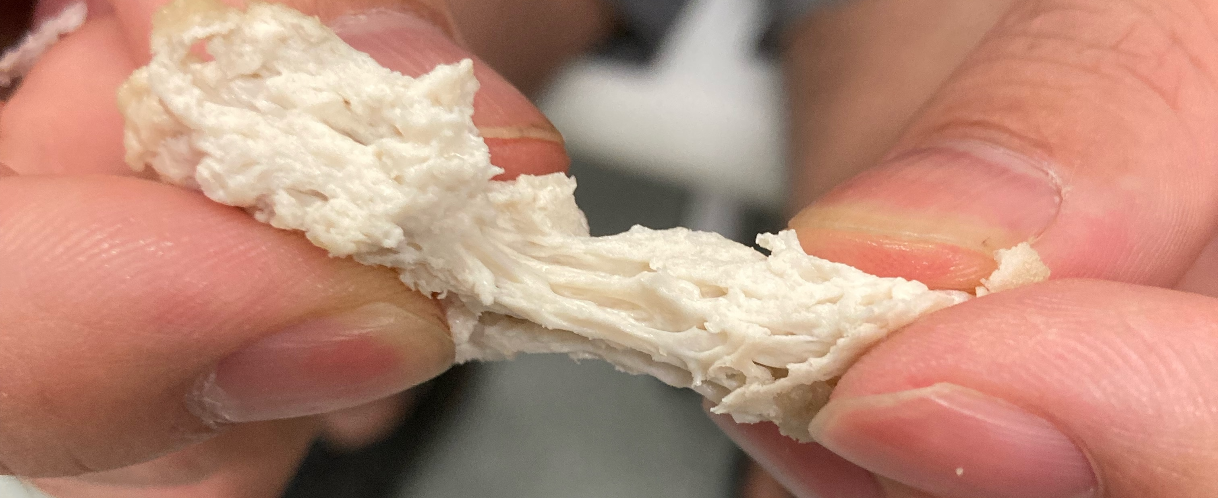
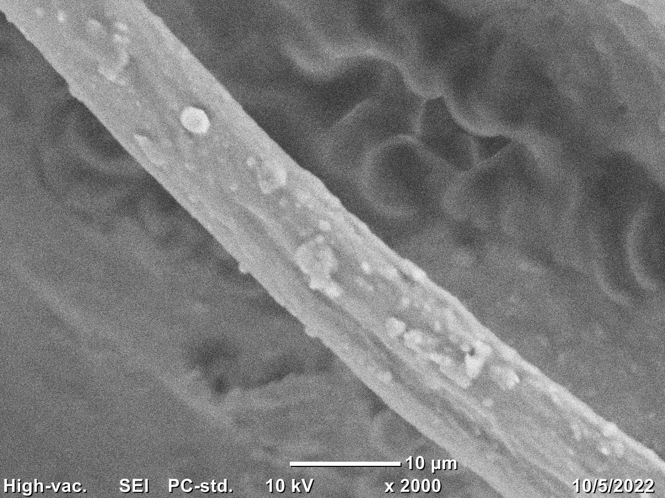
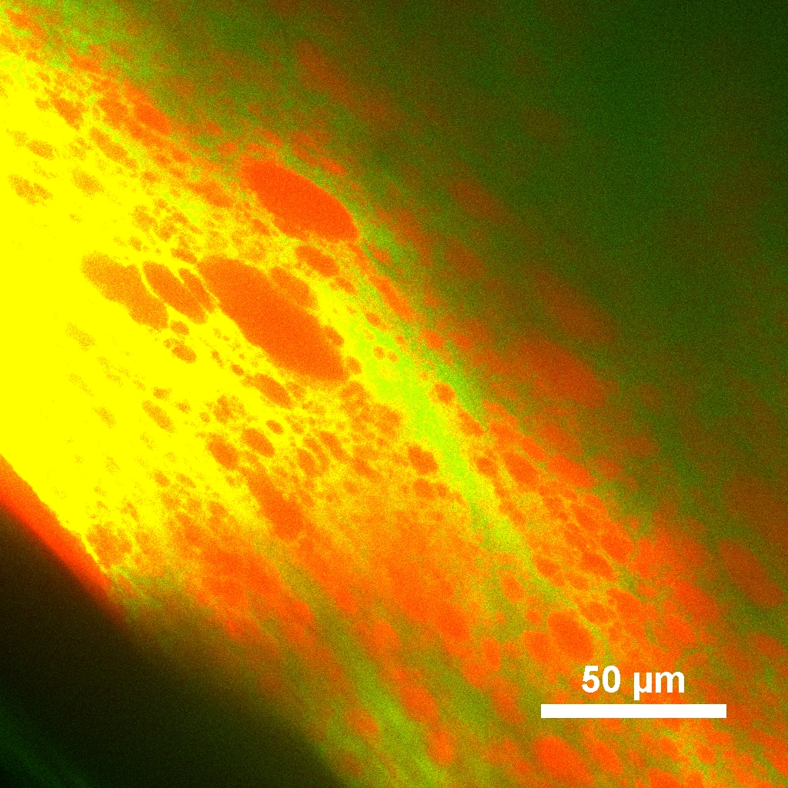
Potato
protein isolate
Shearing
Gelling
Mixed
Coacervation/precipitation
Fiber formation
Polysaccharides
~10 μm fiber

Slide 3
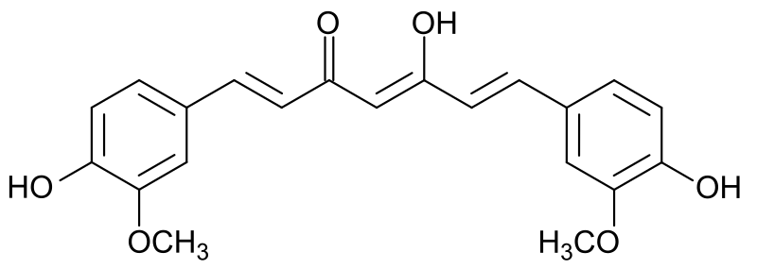
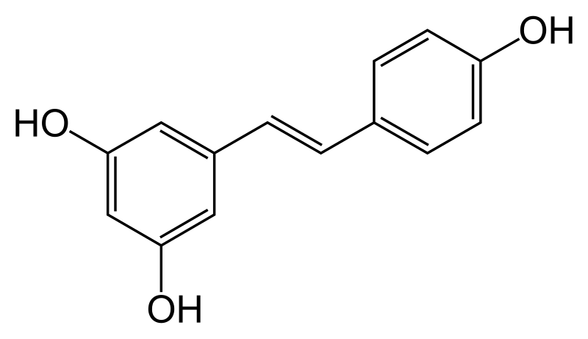
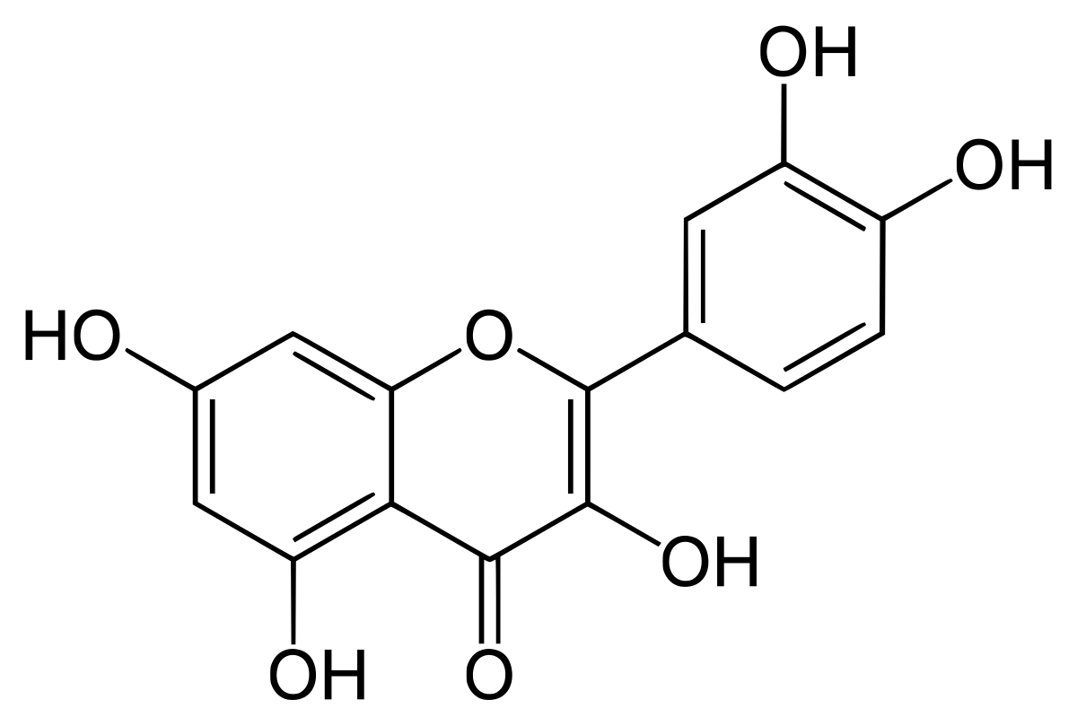
(A)
(B)
Curcumin
Resveratrol
Quercetin
Figure 3. (A) The water solubility of three polyphenols (curcumin, resveratrol, and quercetin) under different pH values. Data were obtained from an online database (chemicalize.com). (B) The chemical structures of polyphenols and potential structural groups to be deprotonated are cycled in red.

Slide 4
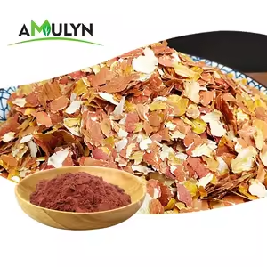
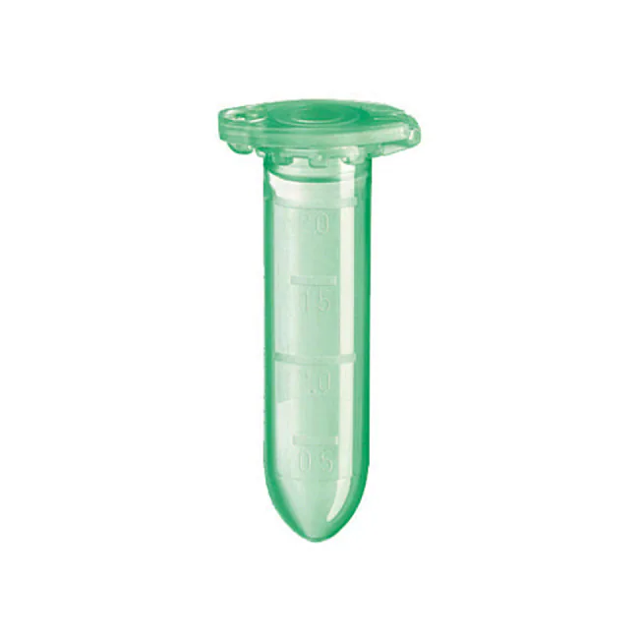
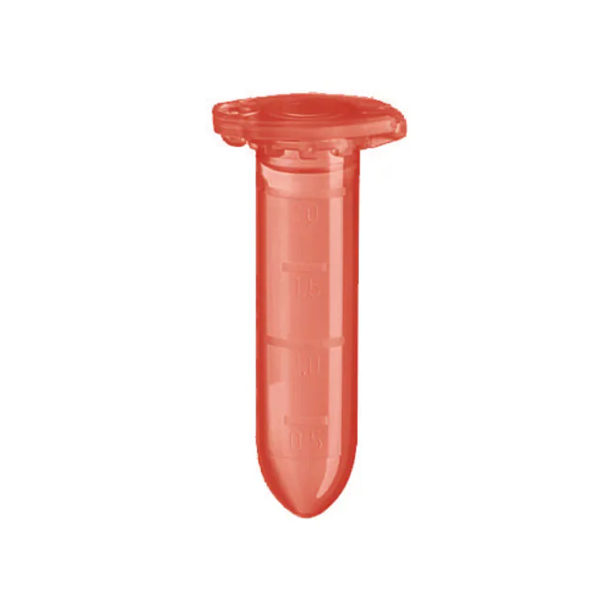
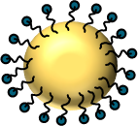

Alkali
Acid
1.8×
1×
1
2
3
Off
4
Post pH-driven (PPD) method for developing peanut skin-powered foods

Slide 5
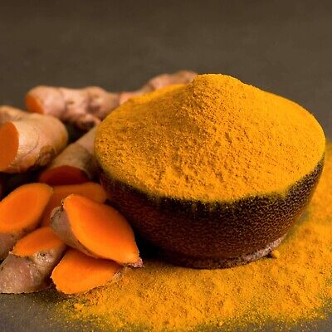
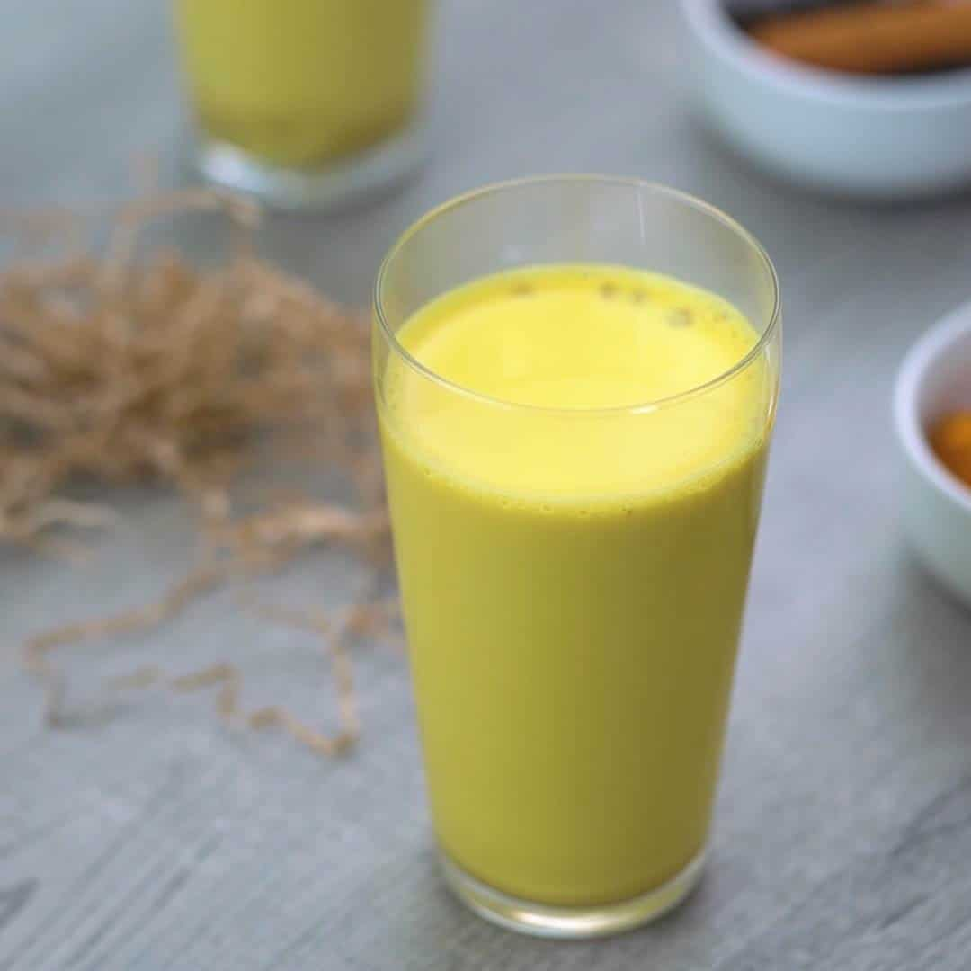
Alkaline-solubilized hydrophilic or lipophilic polyphenols
Extraction
Alkali
Acidic buffer
Raw turmeric
Encapsulation
1
2
3
Off
4
Turmeric-soymilk
Two-in-one post pH-driven processing strategy
Figure 2. A two-in-one PPD approach for developing health-promoted curcumin-enhanced soymilk. The bioactive curcumin molecules can be directly extracted from raw turmeric material and then encapsulated into soymilk. The PPD approach can be fully optimized to ensure a high extraction/encapsulation efficiency.
Notes:
Keys of PPD approach, compared to previous PPD
1) Raw-to-end strategy: this approach can be directly used to create the end-product (such as curcumin-enhanced soymilk) from the raw turmeric material
2) Highly optimized: this approach can be optimized to minimize the chemical degradation of polyphenols in raw plant materials, for example minimizing the oxygen levels

Slide 6
(A)
(B)
10 x
22 x
1 x
1 x
Figure 9. Total embodied energy (MMBtu) and carbon emissions (kg CO2-eq) of raw materials for producing both turmeric-soymilk and curcumin-soymilk powders with ~10 kg curcumin..

Slide 7

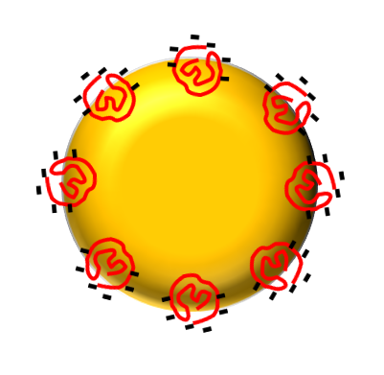
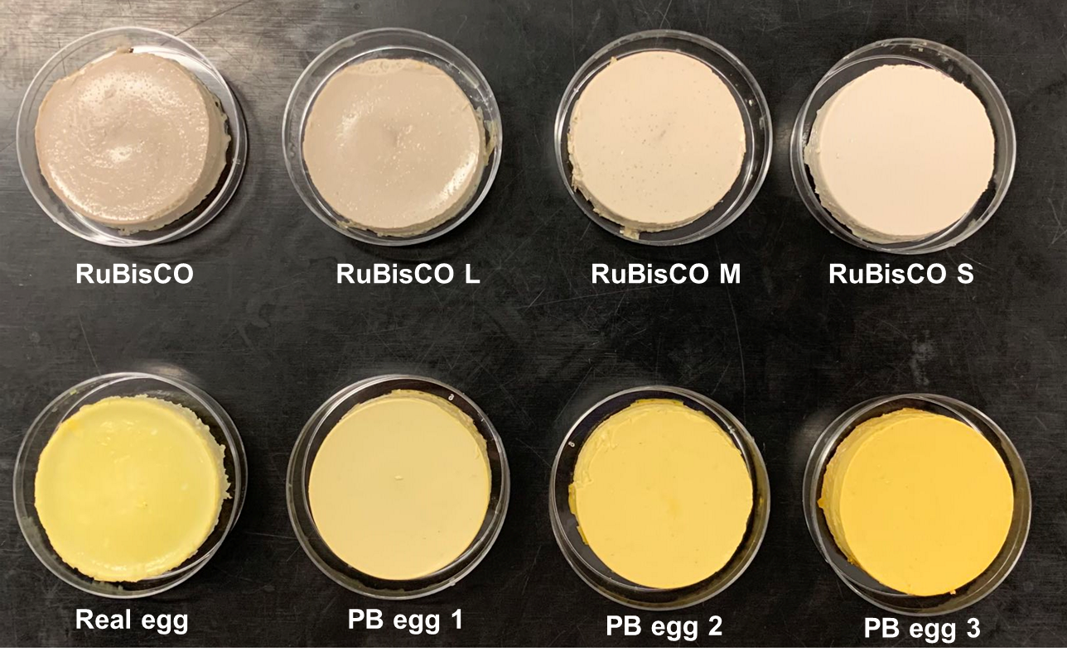
PB egg system
S
M
L
PB egg
Real egg
RuBisCO protein
Lipids
Curcumin or Lutein

Slide 8

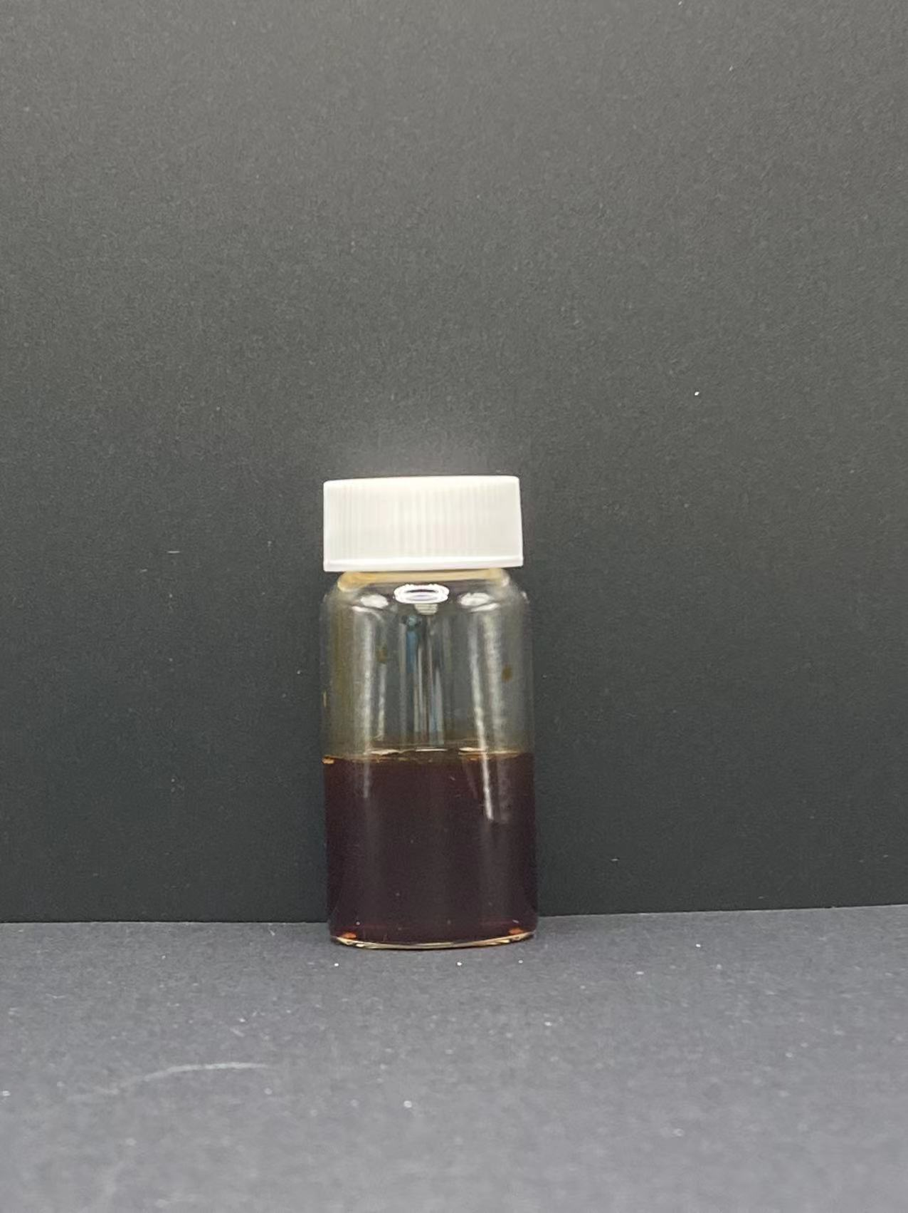
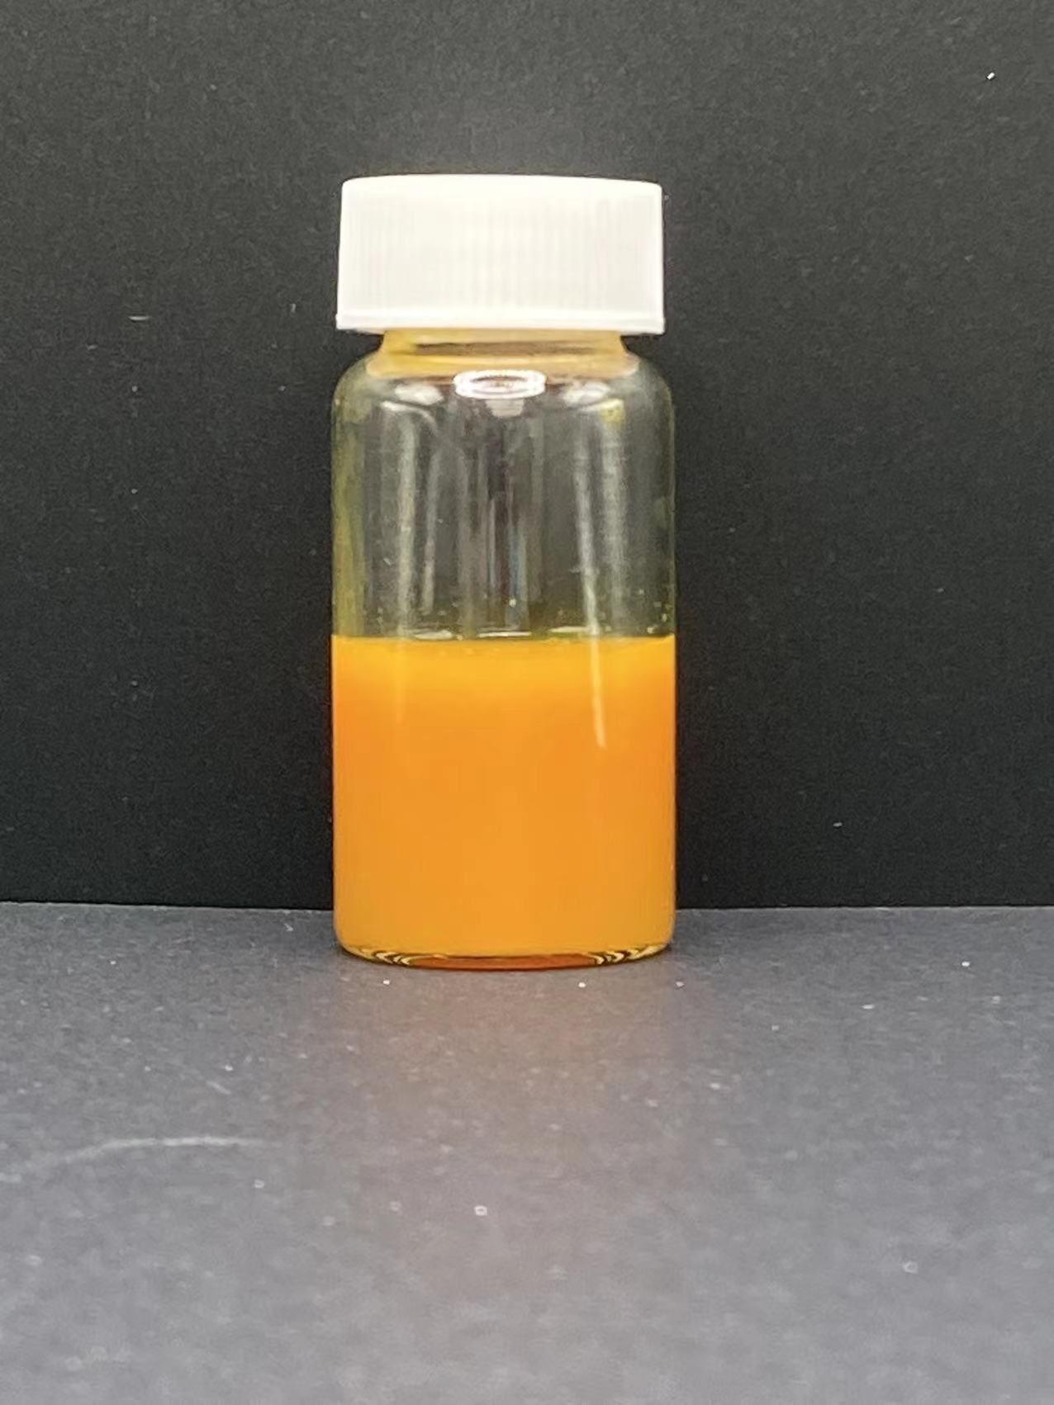
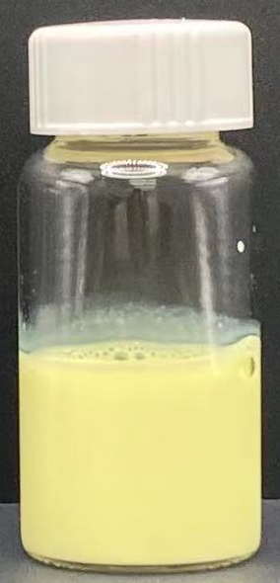

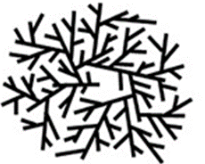
Raw-to-Nano
Raw Plant
Nanoparticles
NaOH
HCl
+Milk
Filtered

Slide 9
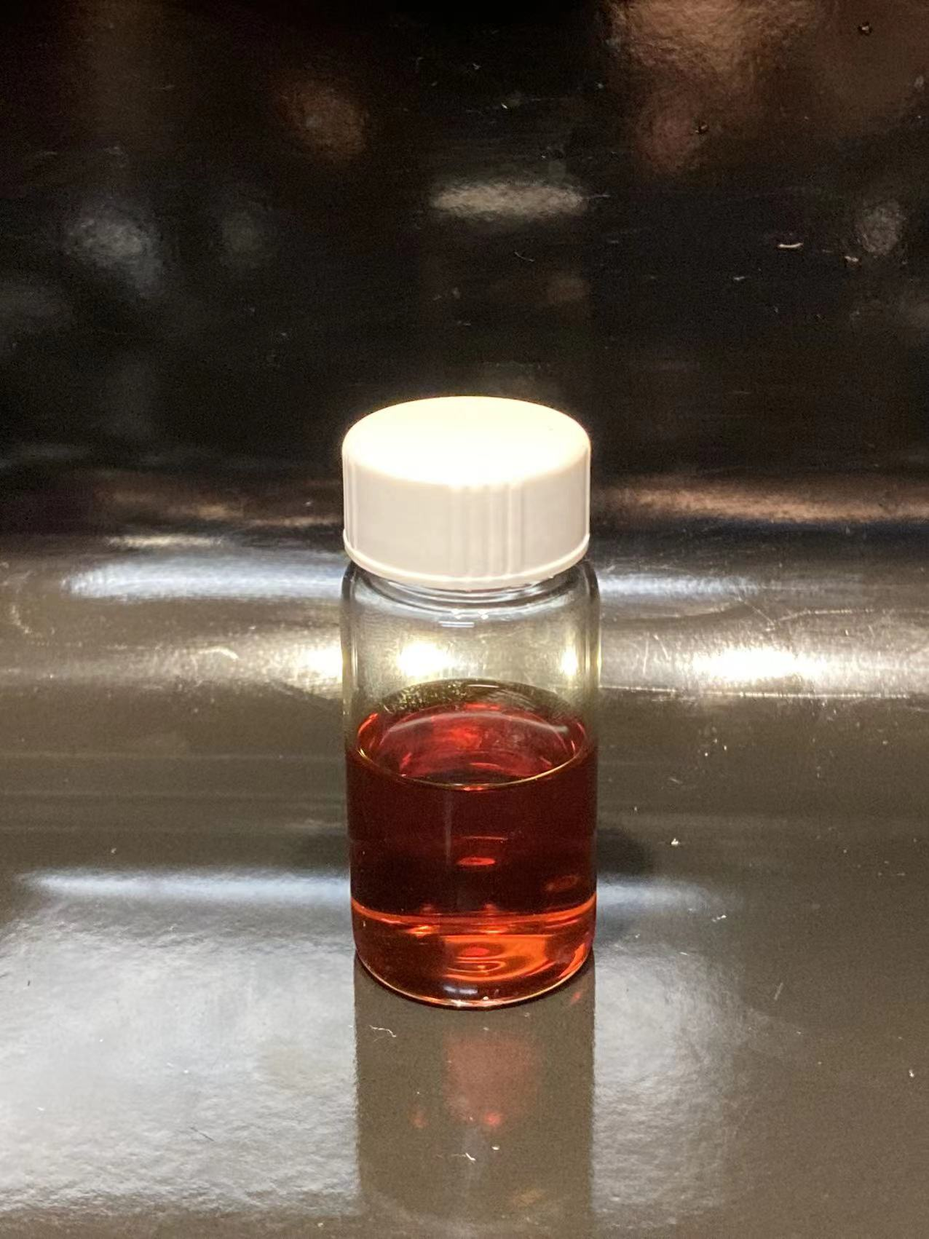
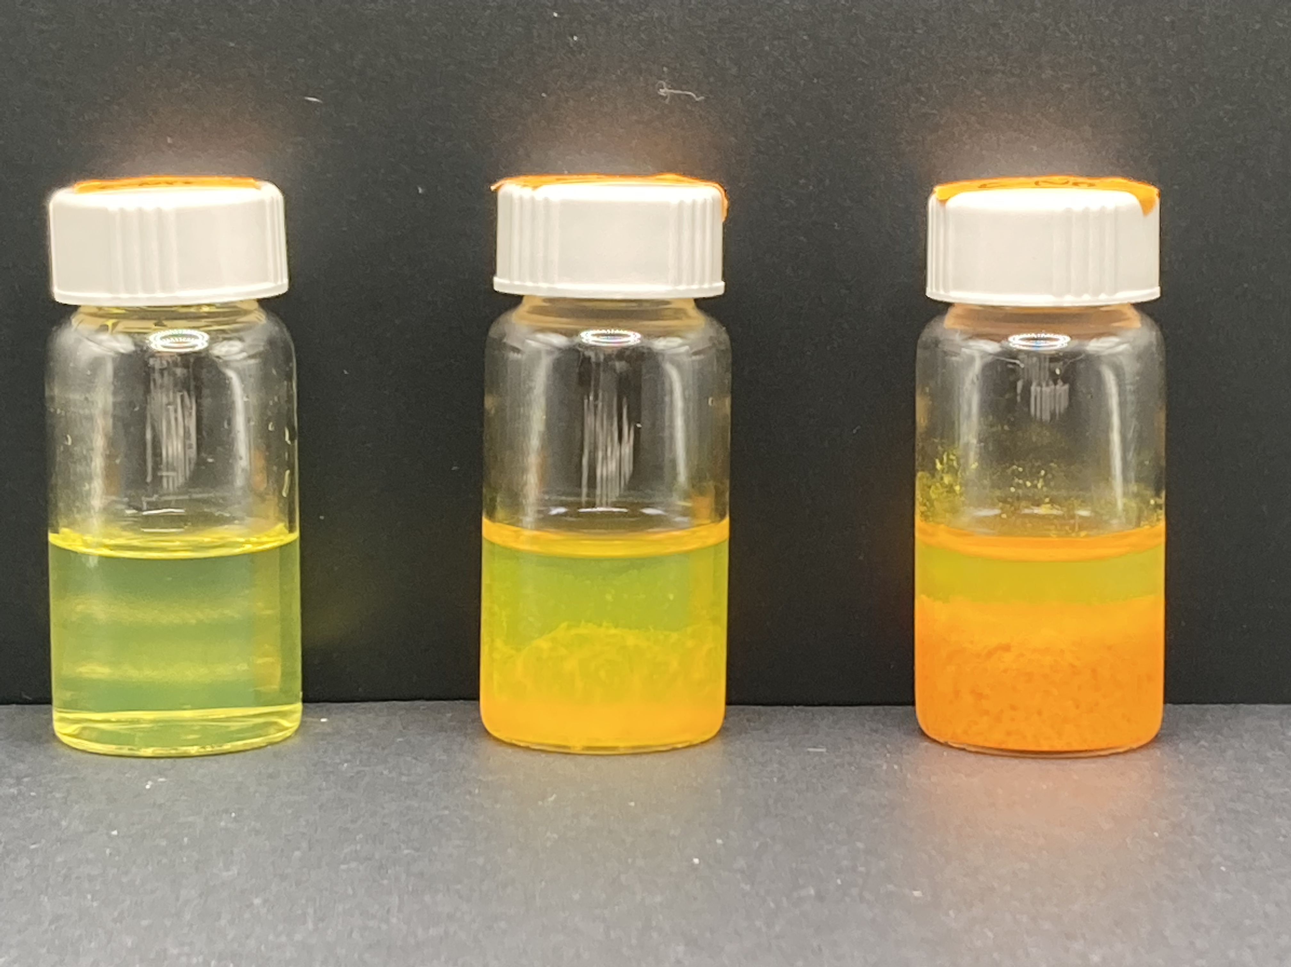
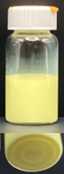
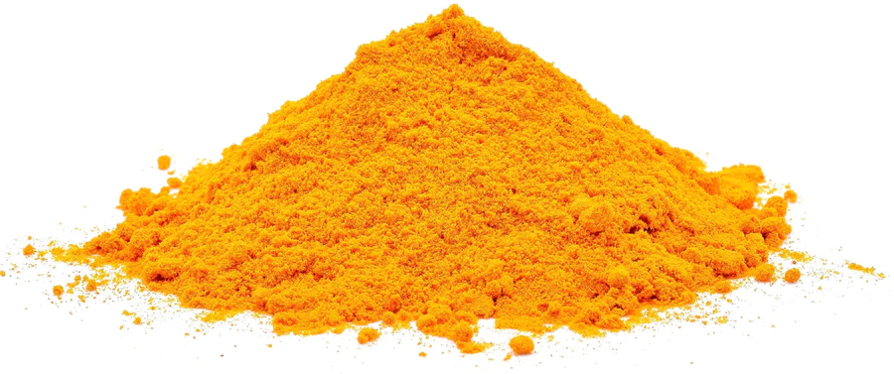
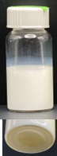
+NaOH
+HCl
+Emulsions
Vs.
Curcumin crystals
+Emulsions

Slide 10

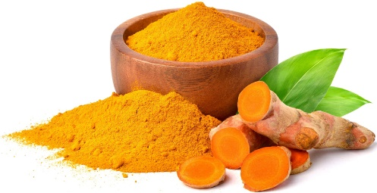
Alkali-acid treatment
Plant-derived components
Structural changes
Plant-derived components | pH-soluble chemical groups
Curcumin | Phenolic -OH
Proteins | Tyrosine (phenolic -OH); Cysteine (-SH); aspartic and glutamic acid (R-COOH), etc.
Acidic polysaccharides | Mannuronic acid and guluronic acid (sugar -COOH)
Starches | Sugar -CH₂OH

